Slide 1
Final Milestone Group 1 SEC 101
Gabriele Chiossi and Ben Marschall

Slide 2
Technology Stack and Tool Chain
We have been using VSCode and VS to edit all our files. As well as a browser to look at the changes that we put in our code.
We used GitHub very often this milestone, because we had some problem so we had to go back a version of the website. Also used different branches when we were developing our unit testing.

Slide 3
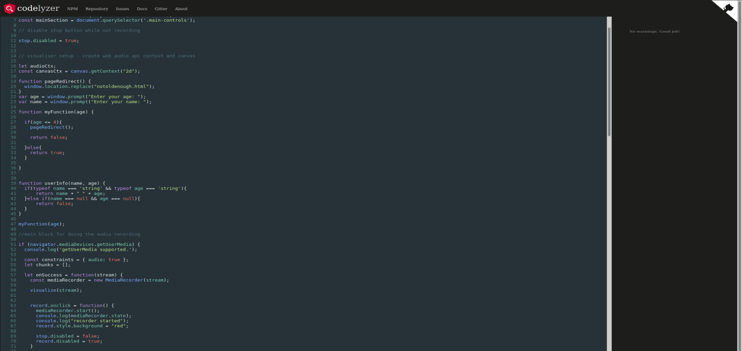
Static Analysis

Slide 4
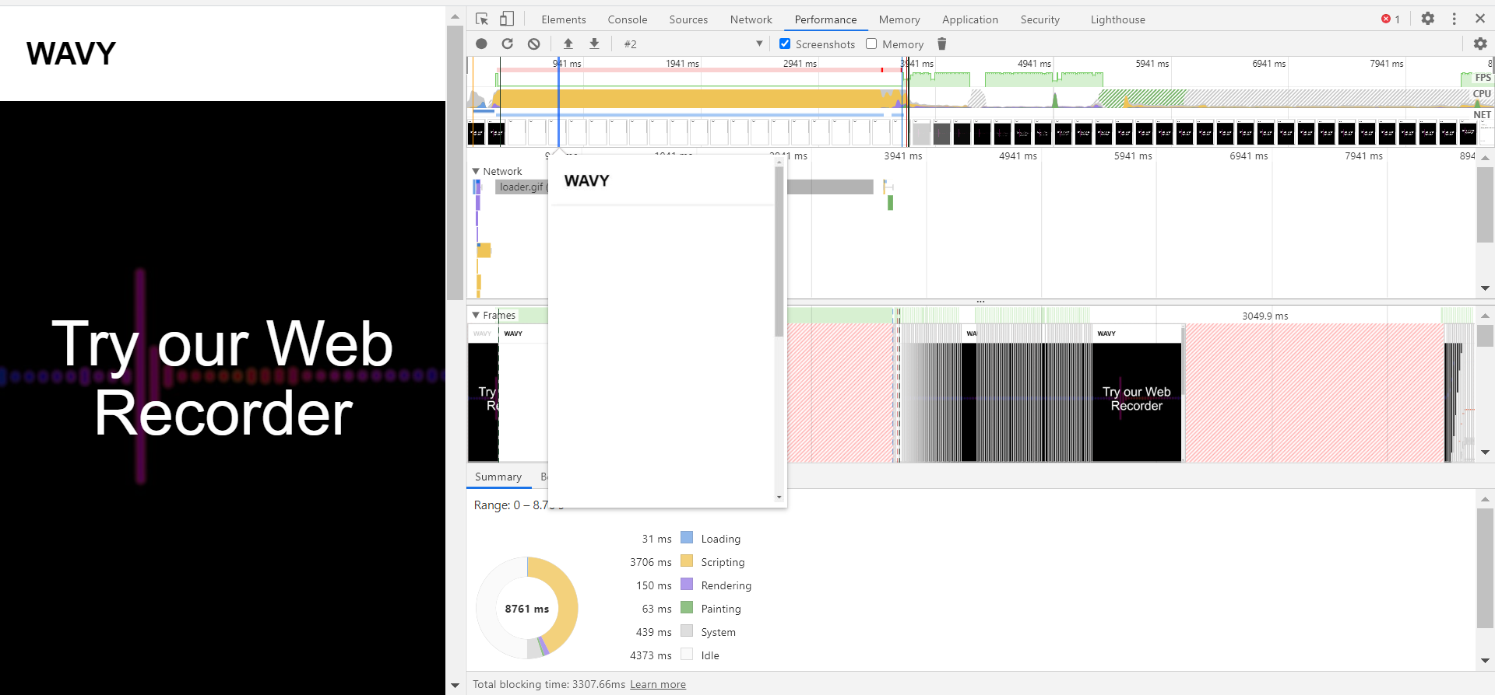
Profiling With Chrome Dev tool

Slide 5
Individual Responsibilities of All Members For This Milestone
Gabriele has fixed a problem with the deletion of the soundclips. Earlier when we were clicking delete the stream would stay, now when we delete the sound the stream goes away with it. Big part of this milestone was figuring out the test cases with mocha, it took him a while but he figured it out. Also he found an online static analysis tool that we use to do our static analysis part of the project. He launched the website on github.io
Ben fixed issue regarding how the visualizers would stack on top of each other and be seperated from their sound bars. Added Text hyperlink linking recording section of page

Slide 6
Individual Contributions During The Entire Project
Gabriele: it was rough at the beginning we had a lot of people dropping and we could not make up our ideas on what to do. So, I took the lead and decided to do the given project in a web format. Developed the front-end and back-end. I was the mantainer for github. Created most of the powerpoints. Develop the unit testing. Keep professors updated on the team situation. Try to find times every week where everybody could meet, when we were more than just two.
Ben: Edited powerpoints for grammar and spelling, Fixed a few minor issues especially with formatting of the index html

Slide 7
Technology/Device Access of all Members
We have a lot of different technological devices that we have access to. We have been using all of the devices below to get the system to work on multiple platforms.
WINDOWS OS
LINUX OS (Virtual Machine, heavy use for this milestone on Gabriele’s side)
TEAMS (to communicate via videocall)
iMessage (to chat daily and update the team)
Browsers: Chrome and Firefox mainly

Slide 8
Reflection on this project
Gabriele: This was a very helpful project; I learned a new language and all the tools that were necessary to develop it. With this newfound knowledge I have decided that I will probably develop here in the next year, using HTML5, CSS3, JavaScript ad SQL. I learned how to use github with a deeper understanding and a more extended knowledge on ssh. All around this was a very good project. My only regret is not having enough time to actually do what I wanted to do with this project.
Ben: I had a great time doing this project. For the most part this was very easy on me as Gabriele took the lead on developing which made it easy to know what exactly to work on. Learned quite a bit of JS for having never programmed in it before and gained a better understanding of html and git. My only regrets are that i didn’t take the time early on to fully undeerstand what the API was capable of and i wish i had worked on individual parts of the project ahead of time, because by the time i would get to them, Gabriele had already finished it.

